Slide 1
ORACLE TASK

Slide 2
a) Create a Manager User and grant them a role of privileges to create two users. Let User 1 create the Employee and the Department table. Let User 2 insert 5 rows of employees.
Code :
Open CMD
write sqlplus
user name -> sys as sysdba
Password -> admin
create role manager_role;
grant create user , create session , create table to manager_role;
Create user manager identified by 123;
grant manager_role to manager;
conn manager / 123;
create user user1 identified by 123;
create user user2 identified by 123;
conn sys as sysdba;

Slide 3
grant create session, create table to user1;
alter user user1 quota 100M on users;
grant create session to user2;
conn user1 / 123;
create table department (
id int primary key,
department_name varchar(50));
create table employees (
id int primary key,
name varchar(50),
salary int ,
department_id int references department(id));
insert into department values (1, 'HR');
insert into department values (2, 'IT');
insert into department values (3, 'Fiance');

Slide 4
grant insert on user1.employees to user2;
conn user2 / 123;
insert into user1.employees values (1, 'zainab', 6000, 1);
insert into user1.employees values (2, 'menna', 6500, 2);
insert into user1.employees values (3, 'mariam', 7000, 3);
insert into user1.employees values(4, 'nourhan', 5000, 1);
insert into user1.employees values(5, 'mohamed', 7500, 2);

Slide 5
the explanation --> The first two lines are not part of the code. They are instructions for opening the CMD and launching sqlplus.
, the user sys as sysdba logs in to the database with the password admin.
, a new role named manager_role is created.
, the manager_role is granted the privileges to create users, sessions, and tables.
, a new user named manager is created with the password 123.
, the manager_role is granted to the user manager.
, the user manager logs in to the database with the password 123.
, two new users named user1 and user2 are created with the password 123.
, the user sys as sysdba logs in to the database again.
, the user user1 is granted the privileges to create sessions and tables.
I, the quota for the user user1 is set to 100 MB on the users tablespace.
, the user user2 is granted the privilege to create sessions.
, the user user1 logs in to the database with the password 123.
, a new table named department is created with two columns: id and department_name. The id column is set as the primary key.

Slide 6
, a new table named employees is created with four columns: id, name, salary, and department_id. The id column is set as the primary key and the department_id column is set as a foreign key referencing the id column of the department table.
, three rows are inserted into the department table.
, the user user2 is granted the privilege to insert rows into the employees table owned by user1.
, the user user2 logs in to the database with the password 123.
, five rows are inserted into the employees table owned by user1.
This code creates a simple database schema with two tables and populates them with some sample data. It also demonstrates how to create users, roles, and grant privileges in an database.

Slide 7
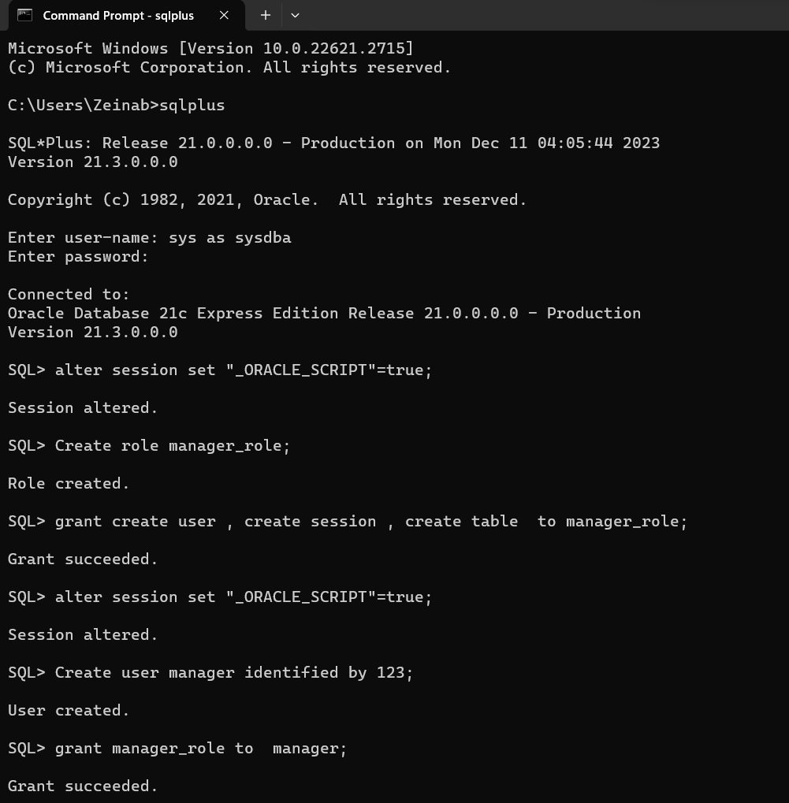

Slide 8
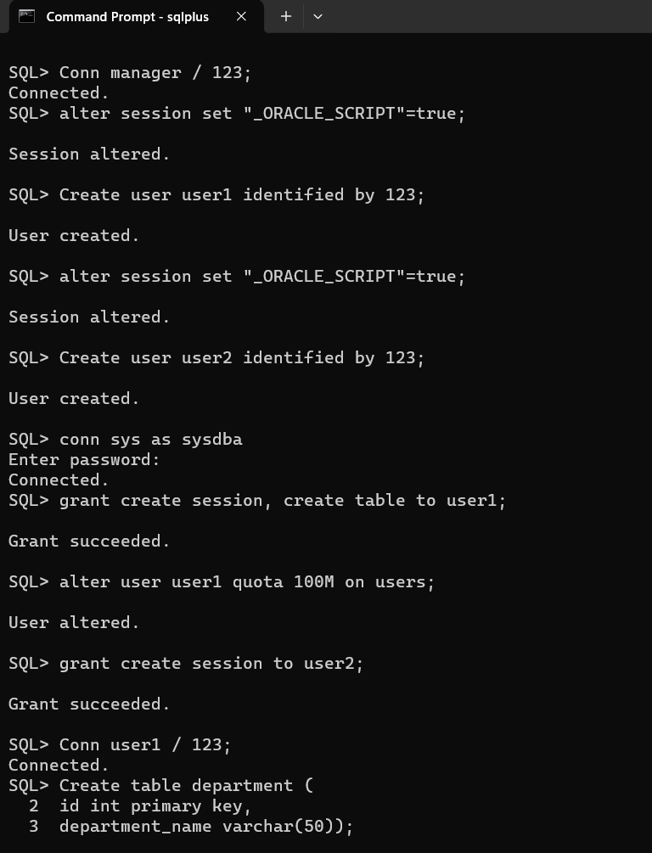

Slide 9
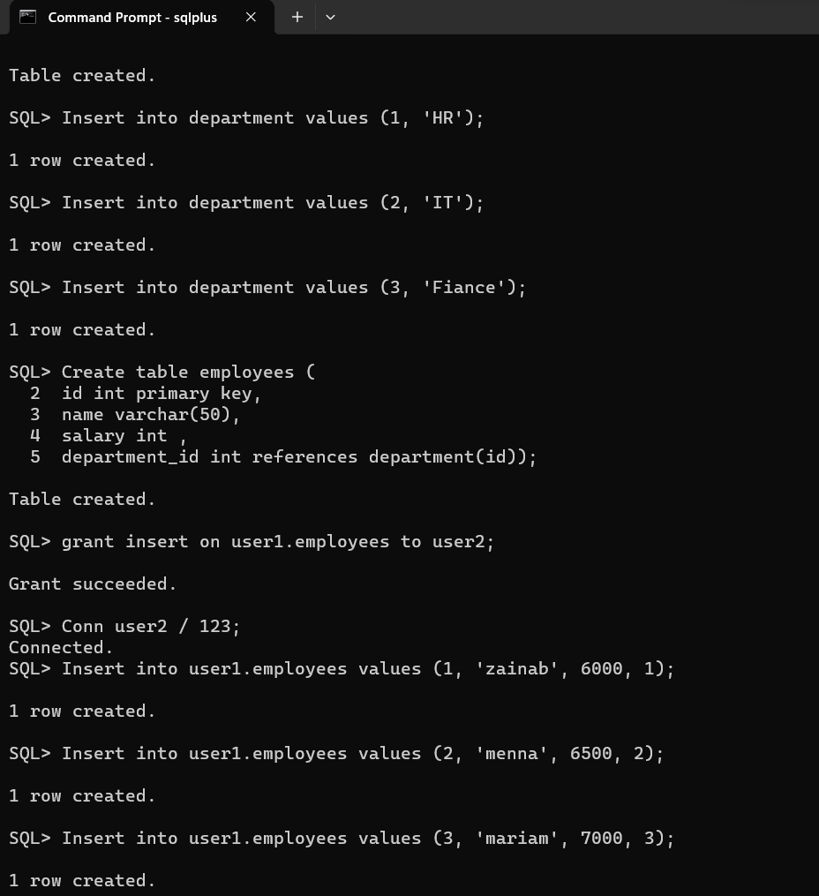

Slide 10
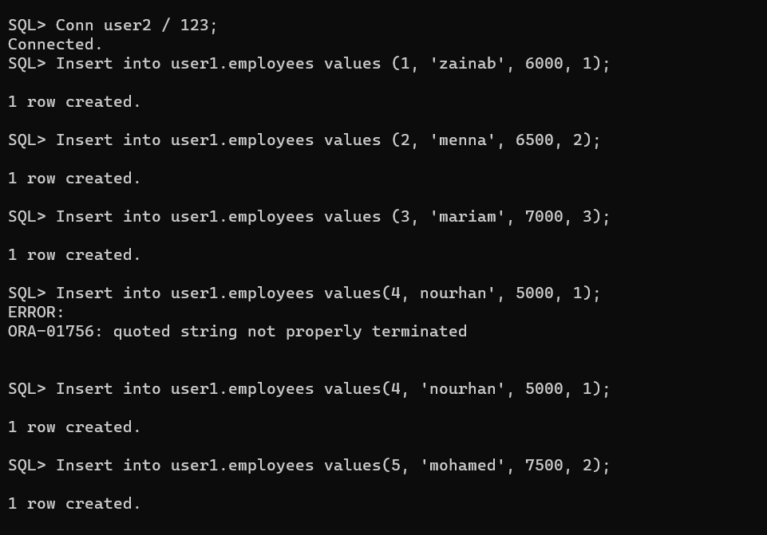

Slide 11
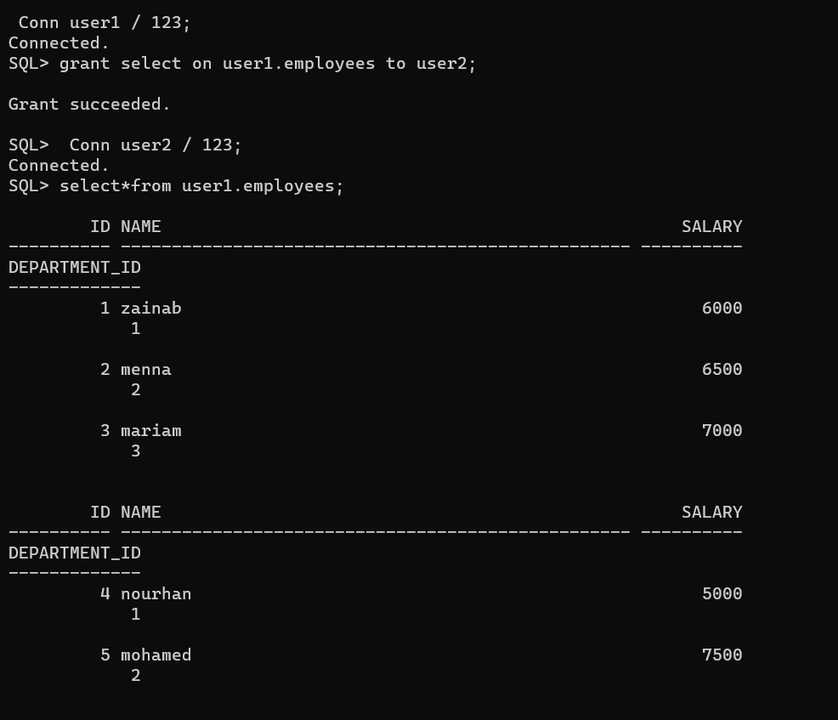

Slide 12
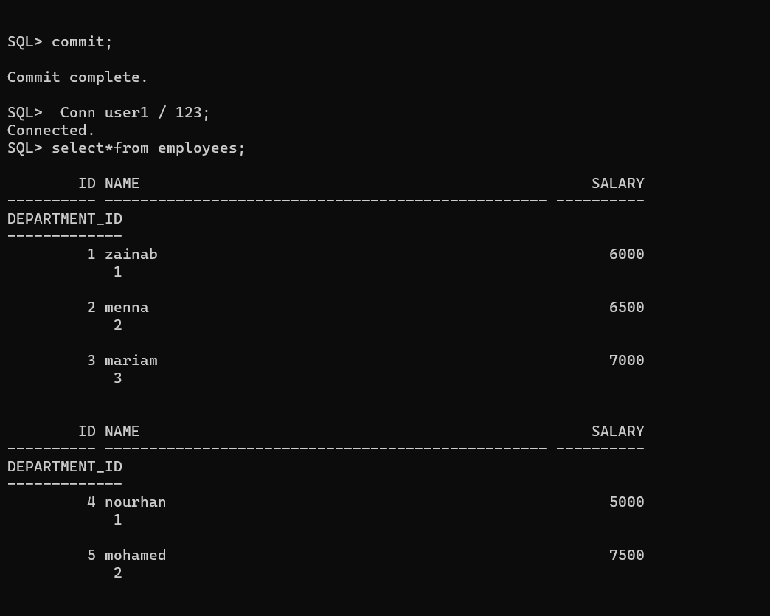

Slide 13
b) Demonstrate generating a blocker-waiting situation using two transactions by user 1 and user 2. The Transaction is calling a function that raises the rate of salary by 10% for department 1.
Code :
create or replace function update_salary(dept_id number)
return number as
begin
if (dept_id = 1)
then
update employees
set salary = salary+salary *.1
where department_id = 1;
commit;
return sql%rowcount;
else
dbms_output.put_line('No updates for department ' || dept_id);
Return 0;
end if ; end update_salary;
/

Slide 14
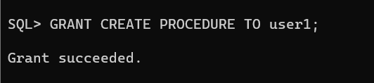
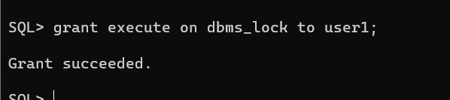
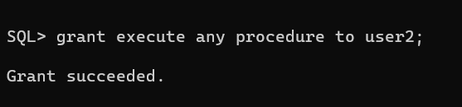
the explanation --> This code creates a function named update_salary that raises the salary of employees in department 1 by 10%. The function takes one input parameter, dept_id, which is the ID of the department for which the salary needs to be updated.
The function first checks if the input parameter is equal to 1. If it is, the function updates the salary of employees in department 1 by adding 10% to their current salary. The SQL%ROWCOUNT function is used to return the number of rows affected by the update statement.
If the input parameter is not equal to 1, the function displays a message indicating that there are no updates for the specified department and returns 0.
The COMMIT statement is used to commit the changes made by the update statement to the database.

Slide 15
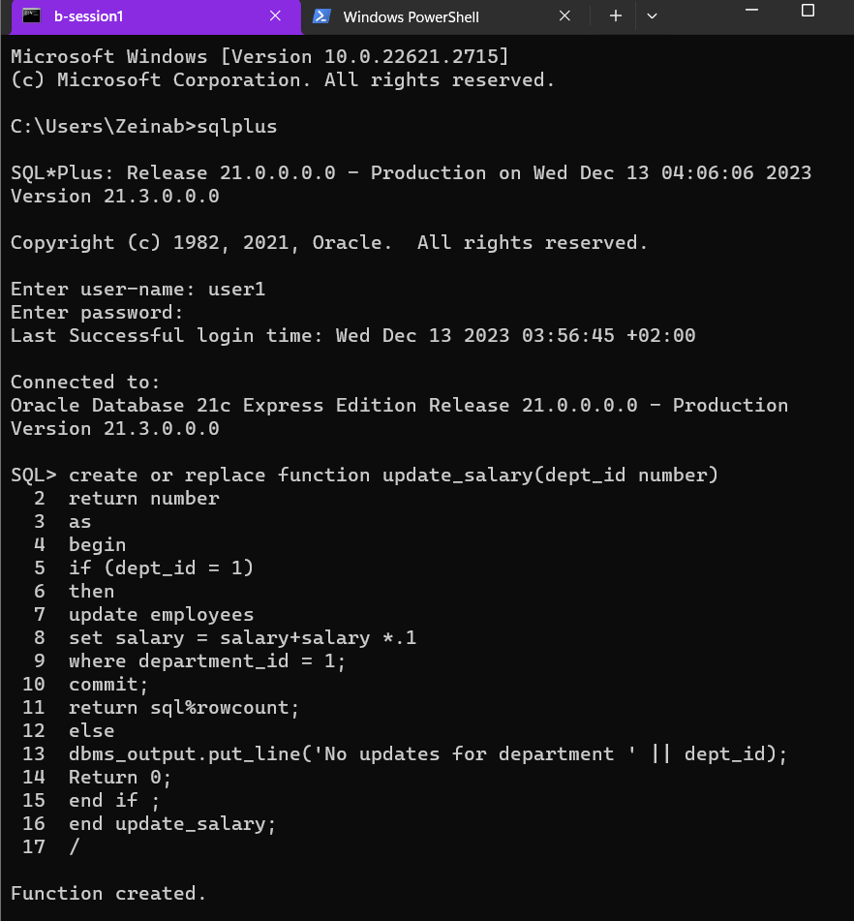

Slide 16
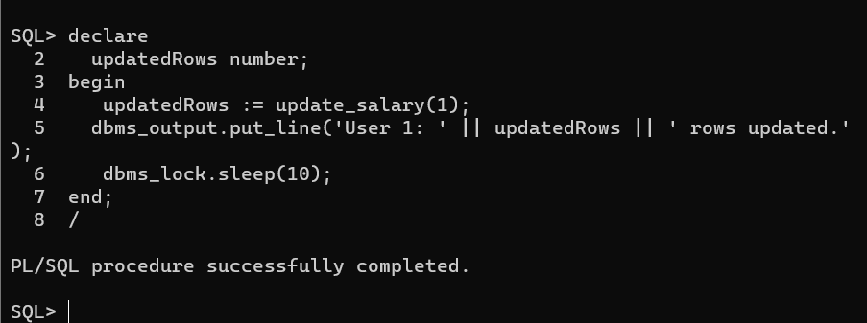
-- User 1
declare
updatedRows number;
begin
updatedRows := update_salary(1);
dbms_output.put_line('User 1: ' || updatedRows || ' rows updated.');
dbms_lock.sleep(10);
end;
/

Slide 17
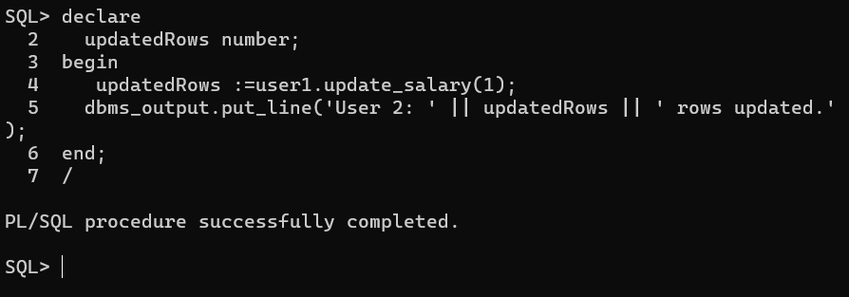
-- User 2
declare
updatedRows number;
begin
updatedRows :=user1.update_salary(1);
dbms_output.put_line('User 2: ' || updatedRows || ' rows updated.');
end;
/

Slide 18
the explanation --> These are two sessions. The first session is initiated by user1 and the second session is initiated by user2
In the first session, user1 is calling a function named update_salary with an argument of 1. The function returns the number of rows updated and assigns it to the variable updatedRows. The dbms_output.put_line statement prints the message User 1: <updatedRows> rows updated. to the console. The dbms_lock.sleep(10) statement pauses the execution of the session for 10 seconds.
In the second session,user2 is calling the same function update_salary with the same argument of 1. However, the function is being called on behalf of user1. The function returns the number of rows updated and assigns it to the variable updatedRows. The dbms_output.put_line statement prints the message User 2: <updatedRows> rows updated. to the console.
when you run both sessions concurrently, you will observe that User 2 is blocked and waiting for User 1's transaction to commit or rollback before proceeding. DBMS_LOCK.SLEEP(10); line in User 1's block, it extend the waiting time and further illustrate the blocker-waiting situation.
Remember, this situation occurs because both users are trying to update the same set of rows in the "Employees" table, specifically those in department 1, leading to contention for the same resources.

Slide 19
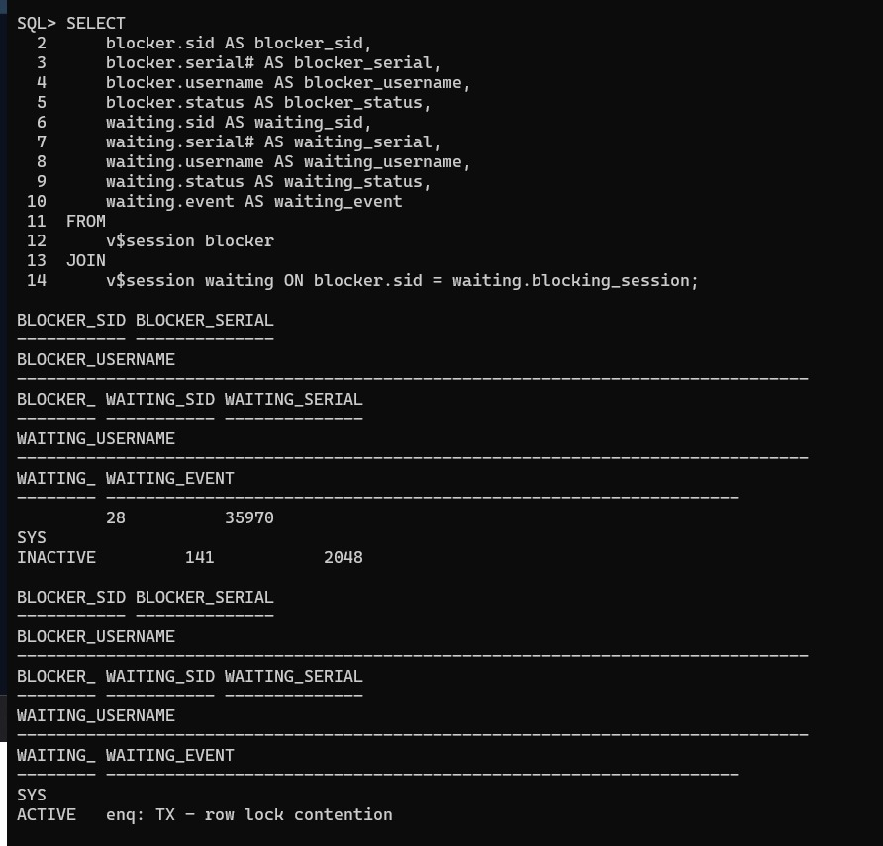
c) Identify the sessions in the situation using SID and serial# for both blocker and waiting sessions.
Code :
SELECT
blocker.sid AS blocker_sid,
blocker.serial# AS blocker_serial,
blocker.username AS blocker_username,
blocker.status AS blocker_status,
waiting.sid AS waiting_sid,
waiting.serial# AS waiting_serial,
waiting.username AS waiting_username,
waiting.status AS waiting_status,
waiting.event AS waiting_event
FROM
v$session blocker
JOIN
v$session waiting ON blocker.sid = waiting.blocking_session;

Slide 20
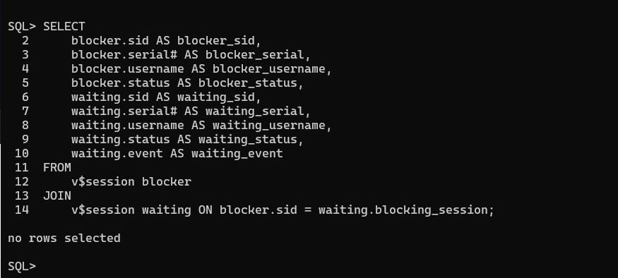
the explanation -->
This code is used to identify the sessions in the situation using SID and serial# for both blocker and waiting sessions. The result of this command will be a table with nine columns: blocker_sid, blocker_serial, blocker_username, blocker_status, waiting_sid, waiting_serial, waiting_username, waiting_status, and waiting_event. The blocker_sid column will contain the SID of the session that is blocking another session, while the waiting_sid column will contain the SID of the session that is waiting for the lock to be released.
The v$session view is used to retrieve information about active sessions in the database. The JOIN clause is used to join the v$session view with itself to identify the blocking and waiting sessions.
Run this query when the blocker-waiting situation is occurring to identify the sessions involved and their respective SID and SERIAL#
the explanation -->
If this command returns no rows , it means
that there is no blocking situation currently
happening in the database.

Slide 21
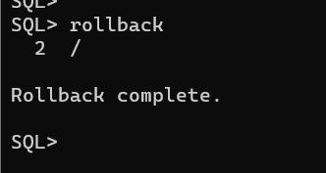
d) Demonstrate a deadlock scenario and display the expected result.
Code :
-- user 1
update employees set salary = salary * 1.1 where id = 2;
update employees set salary = salary * 1.1 where id = 1;
-- user 2
update user1.employees set salary = salary * 1.1 where id = 1;
update user1.employees set salary = salary * 1.1 where id = 2;
the explanation --> User1 and User2 are trying to update the same rows in the Employees table by raising the salary by 10%. This situation can lead to a block waiting scenario if executed synchronously, where both users are trying to update the same set of rows and we will see this in the code where I will execute them synchronously ,if user 1 has already updated the salary for the employee with ID 1, User 2 may be blocked when trying to update the same employee.
should--> commit or rollback the transactions in each session appropriately to release locks and resolve the blocker-waiting situation.

Slide 22
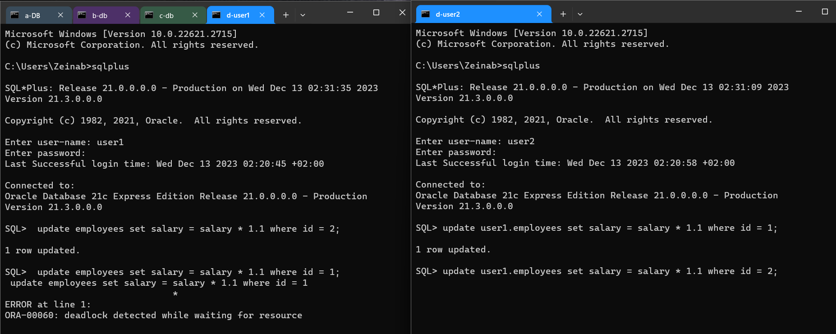

Slide 23
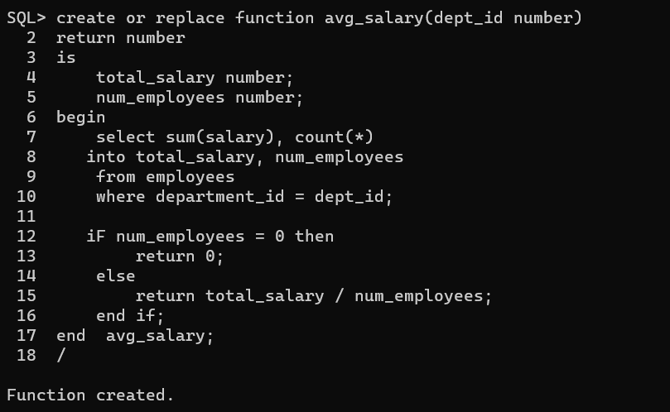
e) Perform the following functions Create a function that calculates the average salary for any department.
Code :
create or replace function avg_salary(dept_id number)
return number is
total_salary number;
num_employees number;
begin
select sum(salary), count(*)
into total_salary, num_employees
from employees
where department_id = dept_id;
iF num_employees = 0 then
return 0;
else
return total_salary / num_employees;
end if;
end avg_salary;
/

Slide 24
the explanation -->
This code creates a function named avg_salary that calculates the average salary for any department. The function takes one input parameter, dept_id, which is the ID of the department for which the average salary needs to be calculated.
The function first declares two variables, total_salary and num_employees, which will be used to store the total salary and number of employees in the specified department, respectively.
Then, the function uses a SELECT statement to retrieve the sum of salaries and the count of employees in the specified department. The SUM function is used to calculate the total salary, while the COUNT function is used to calculate the number of employees. The results of this query are stored in the total_salary and num_employees variables using the INTO clause.
Next, the function checks if the number of employees is zero. If it is, the function returns zero. Otherwise, the function calculates the average salary by dividing the total salary by the number of employees and returns the result.

Slide 25
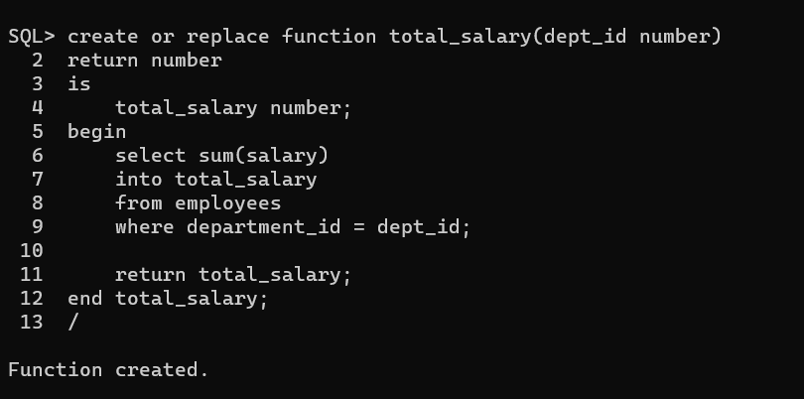
Create a function that calculates the Total Salary in a Department.
Code :
create or replace function total_salary(dept_id number)
return number
is
total_salary number;
begin
select sum(salary)
into total_salary
from employees
where department_id = dept_id;
return total_salary;
end total_salary;
/

Slide 26
the explanation -->
This code creates a function named total_salary that calculates the total salary for any department. The function takes one input parameter, dept_id, which is the ID of the department for which the total salary needs to be calculated.
The function first declares a variable, total_salary, which will be used to store the total salary of the specified department.
Then, the function uses a SELECT statement to retrieve the sum of salaries in the specified department. The SUM function is used to calculate the total salary. The result of this query is stored in the total_salary variable using the INTO clause.
Finally, the function returns the total salary.

Slide 27
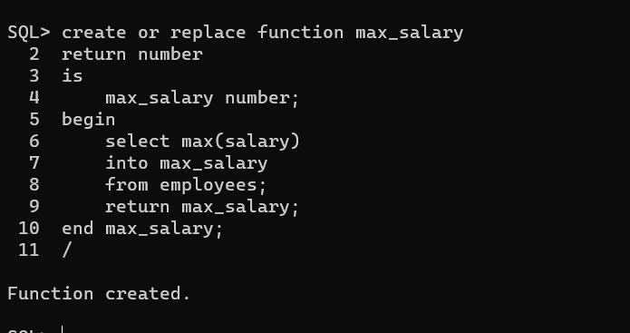
Create a function that calculates the maximum Salary.
Code :
create or replace function max_salary
return number
is
max_salary number;
begin
select max(salary)
into max_salary
from employees;
return max_salary;
end max_salary;
/

Slide 28
the explanation -->
This code creates a function named max_salary that calculates the maximum salary of all employees. The function does not take any input parameters.
The function first declares a variable, max_salary, which will be used to store the maximum salary of all employees.
Then, the function uses a SELECT statement to retrieve the maximum salary of all employees. The MAX function is used to calculate the maximum salary. The result of this query is stored in the max_salary variable using the INTO clause.Finally, the function returns the maximum salary.

Slide 29
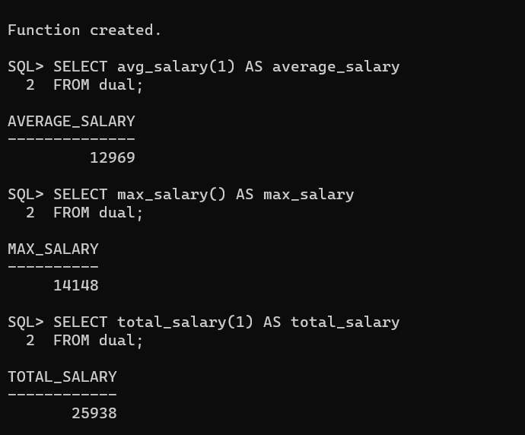
-- using the functions
SELECT avg_salary(1) AS average_salary
FROM dual;
SELECT total_salary(1) AS total_salary
FROM dual;
SELECT max_salary() AS max_salary
FROM dual;

Slide 30
Full name | ID
منه الله هرمس مصطفى محمد | 20210964
مريم عمادالدين عباس سعيد | 20210919
مريم احمد محمود محمد | 20210906
نورهان فؤاد محمد ابوسريع | 20211017
نورهان مجدى عبدالمولي علي | 20211019
زينب تامر اسماعيل وهبه | 20210385
زينب هاشم عبدالله الخولى | 20210388

